Slide 1
CSP-Guard
AI-Based Context-Aware Code Safety & Copy-Paste Risk Analyzer
PROJECT TEAM
Keerthi Surya Teja • 2303A52007
Boga Siri Chandana • 2303A52004
Bijjala Vrindha • 2303A52003
Thakur Akshaya • 2303A52017
Ai Assisted Coding Project

Slide 2
02 Introduction
What is CSP-Guard?
The Problem It Solves
CSP-Guard is an AI-powered security tool that automatically detects dangerous code reuse resulting from copy-paste actions in software development.
Unlike conventional clone detectors that rely only on syntactic similarity, CSP-Guard performs multi-dimensional analysis incorporating syntax, semantics, and security simultaneously.
The core innovation is the Execution Context Delta (ECD) model, which quantifies contextual divergence between source and destination code and converts it into an actionable risk score.
Context Inconsistency
Incompatible variables & scopes when code is lifted from one context to another.
Missing Error Handling
Error-handling routines specific to original context are stripped out silently.
Security Weaknesses
Code injection and other vulnerabilities introduced through unchecked code reuse.
Compliance Failures
Regulatory & audit risks when security logic doesn't transfer with copied code.
CSP-Guard | SR University, Warangal | 2026

Slide 3
03 Objectives
Detect Copy-Paste Risks Automatically
Introduce ECD — Execution Context Delta
01
Build an automated system that identifies potentially dangerous code reuse in real-time within the IDE and CI/CD pipelines.
02
Develop the first-of-its-kind metric that quantifies contextual divergence across variable scope, taint flow, exception handling, and resource usage.
Multi-Dimensional Security Analysis
Probabilistic Risk Scoring
03
Combine syntax (AST), semantics (data-flow), and security (vulnerability patterns) into a unified analysis pipeline.
04
Convert contextual differences into a composite risk score using a probabilistic formula: Risk = 1 − ∏(1 − wᵢ·δᵢ).
Minimize False Positives
Support Multi-Language Environments
05
Achieve a false positive rate below 3% — validated at 2.1% — to reduce developer alert fatigue and build trust.
06
Provide language-specific models for Python, Java, and JavaScript with plans for further language expansion.
CSP-Guard | SR University, Warangal | 2026

Slide 4
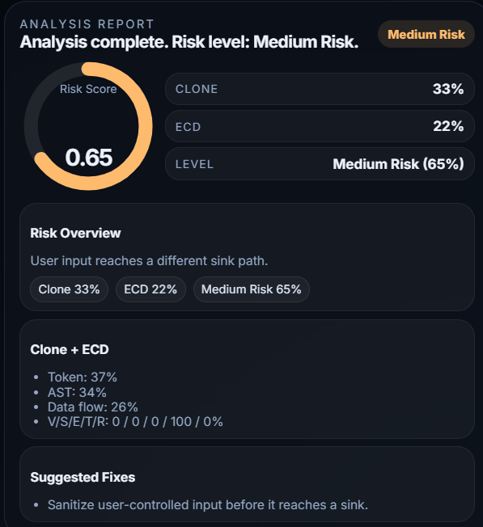
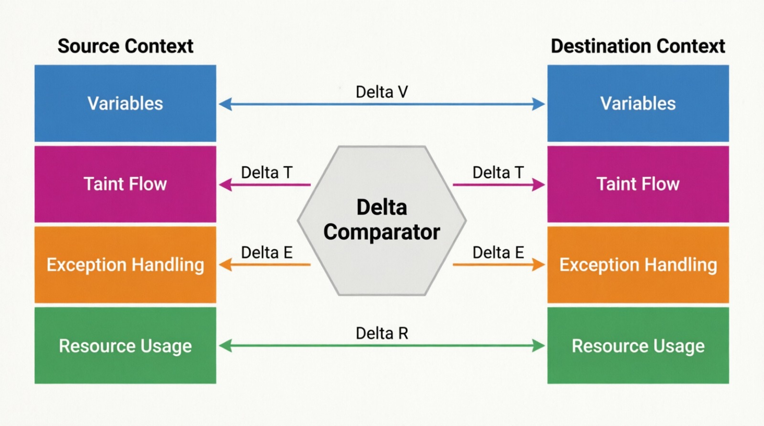
ECD (Execution Context Delta)
V (Vulnerabilities): Detects known security flaws
S (Sources): Identifies untrusted data inputs
E (Execution): Checks risky operations
T (Trust): Indicates safety level
R (Risk): Final risk score
Example:
AST = Abstract Syntax Tree
CSP-Guard | SR University, Warangal | 2026

Slide 5
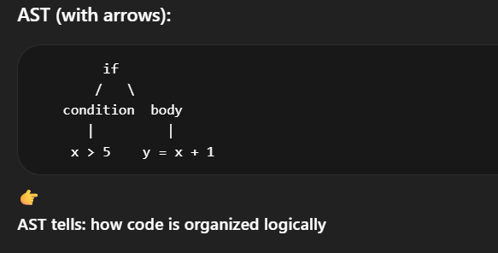
ECD (Execution Context Delta)
Example:
AST = Abstract Syntax Tree
Token tells: what elements are present in code
Data Flow tells: how data moves and changes
CSP-Guard | SR University, Warangal | 2026

Slide 6
04 Stakeholders — For Whom the Project is Done
👨‍💻 Software Developers
🔒 Security Engineers
⚙️ DevOps / CI-CD Teams
Receive real-time IDE alerts when pasting code from a different context, preventing the accidental introduction of security vulnerabilities.
Gain automated visibility into copy-paste-induced risks across large codebases — augmenting manual code review with AI-driven risk scores.
Integrate CSP-Guard into pipelines to block or flag high-risk code automatically on every commit, ensuring no vulnerable code reaches production.
📋 Enterprise Compliance Officers
🎓 Academic Researchers
🏛️ SR University / IDP Faculty
Use audit reports generated by CSP-Guard to satisfy regulatory requirements (GDPR, SOC 2, PCI-DSS) around secure coding practices.
Leverage the ECD model and dataset as a research artifact for further study in code clone analysis, AI-driven security, and static analysis.
Evaluate the project as an Innovation Disclosure and student patent filing — contributing to university IP and R&D outcomes.
CSP-Guard | SR University, Warangal | 2026

Slide 7
05 Programming Languages, Tools & Software
Programming Languages
AI API
HTML
CSS JS
Used Openrouter Free Api Route Key
Development Tools
VS Code — IDE integration & plugin development
Git / GitHub — Version control & collaboration
CSP-Guard | SR University, Warangal | 2026

Slide 8
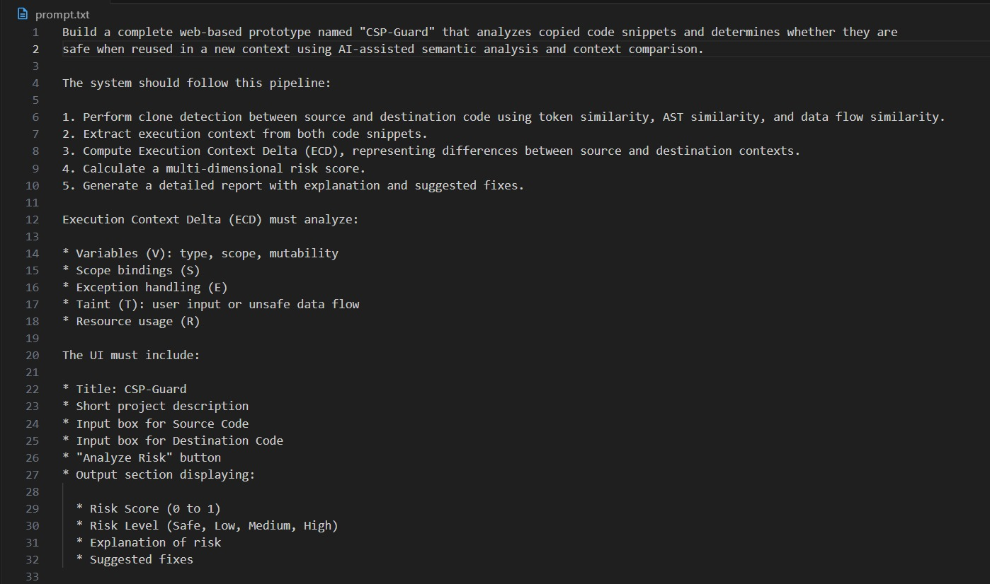
06 Prompts Used to Generate Code (Part 1 of 2)
CSP-Guard | SR University, Warangal | 2026

Slide 9
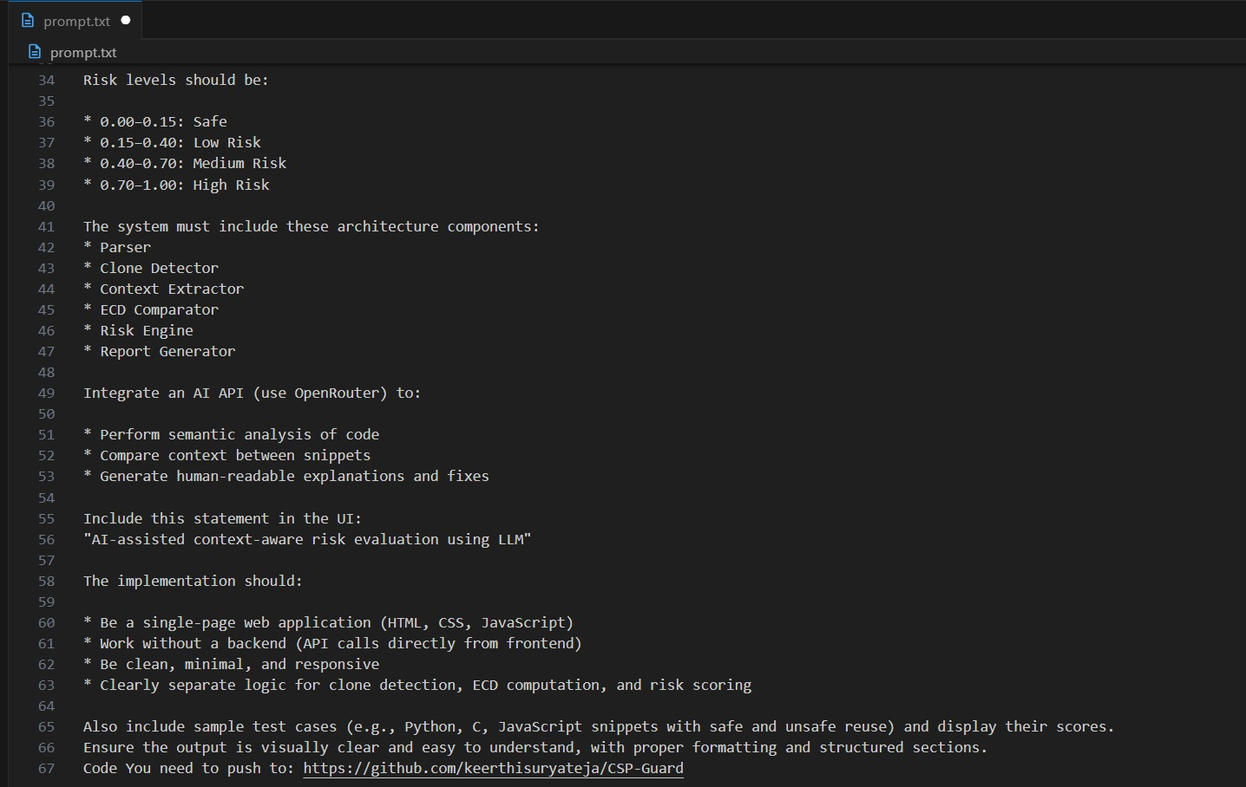
06 Prompts Used to Generate Code (Part 2 of 2)
CSP-Guard | SR University, Warangal | 2026

Slide 10
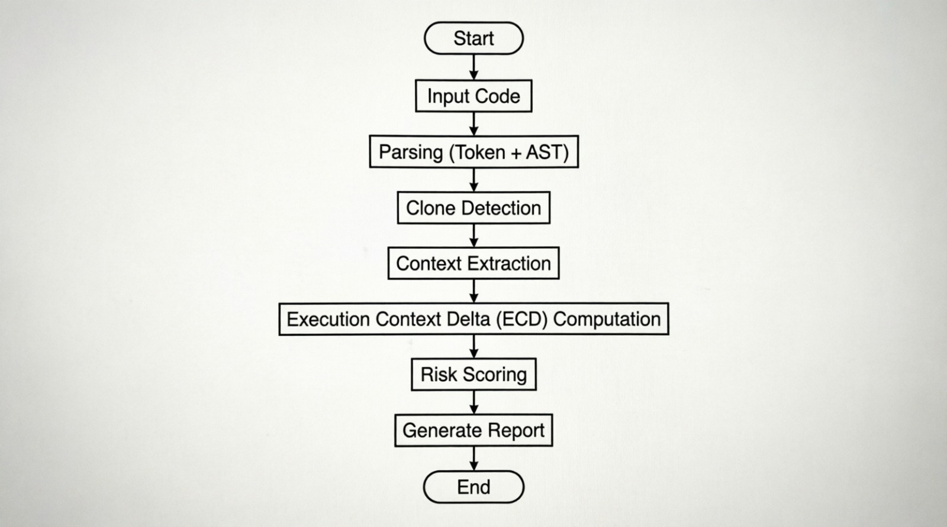
07 Workflow Flowchart
Step 1 | Cod Input & AST Parsing
ectoken + AST)
Step 3 | Context Extraction
★)
tic Risk Scoring
CSP-Guard | SR University, Warangal | 2026

Slide 11
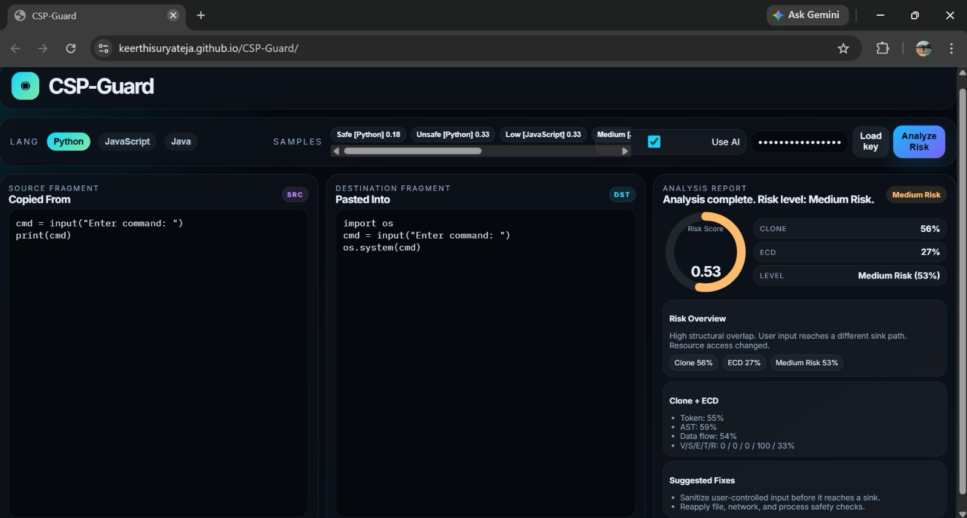
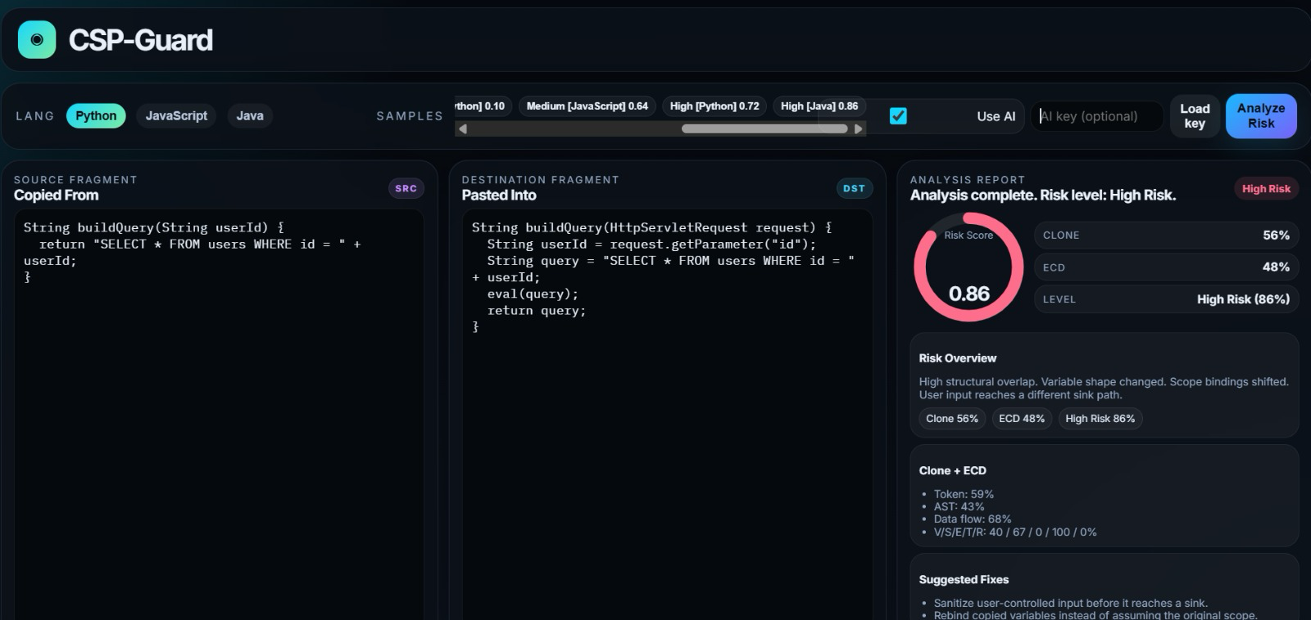
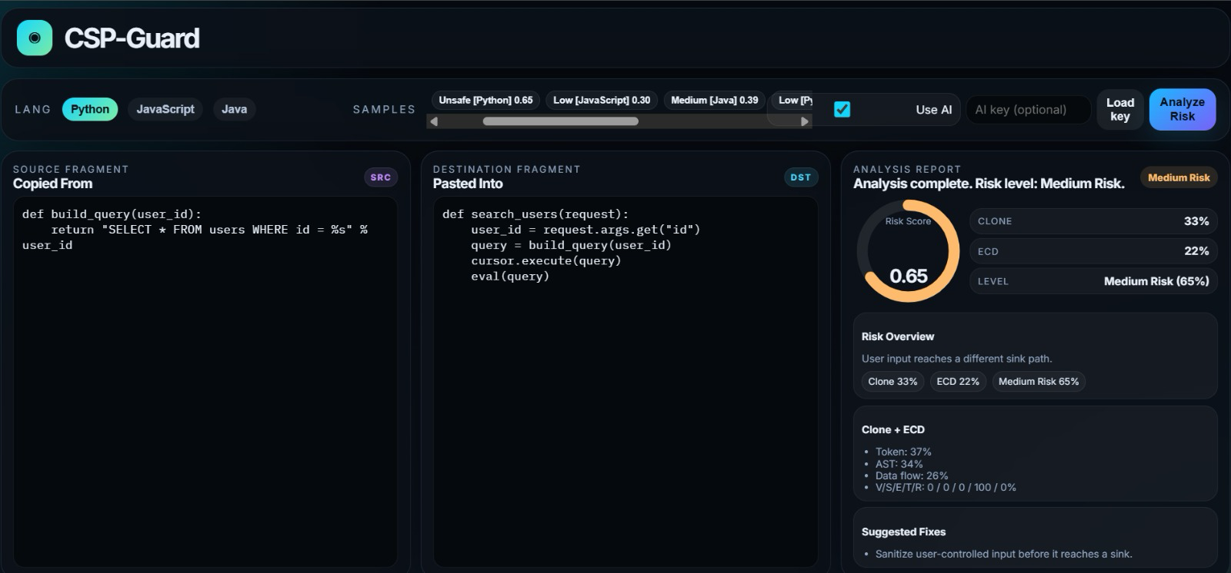
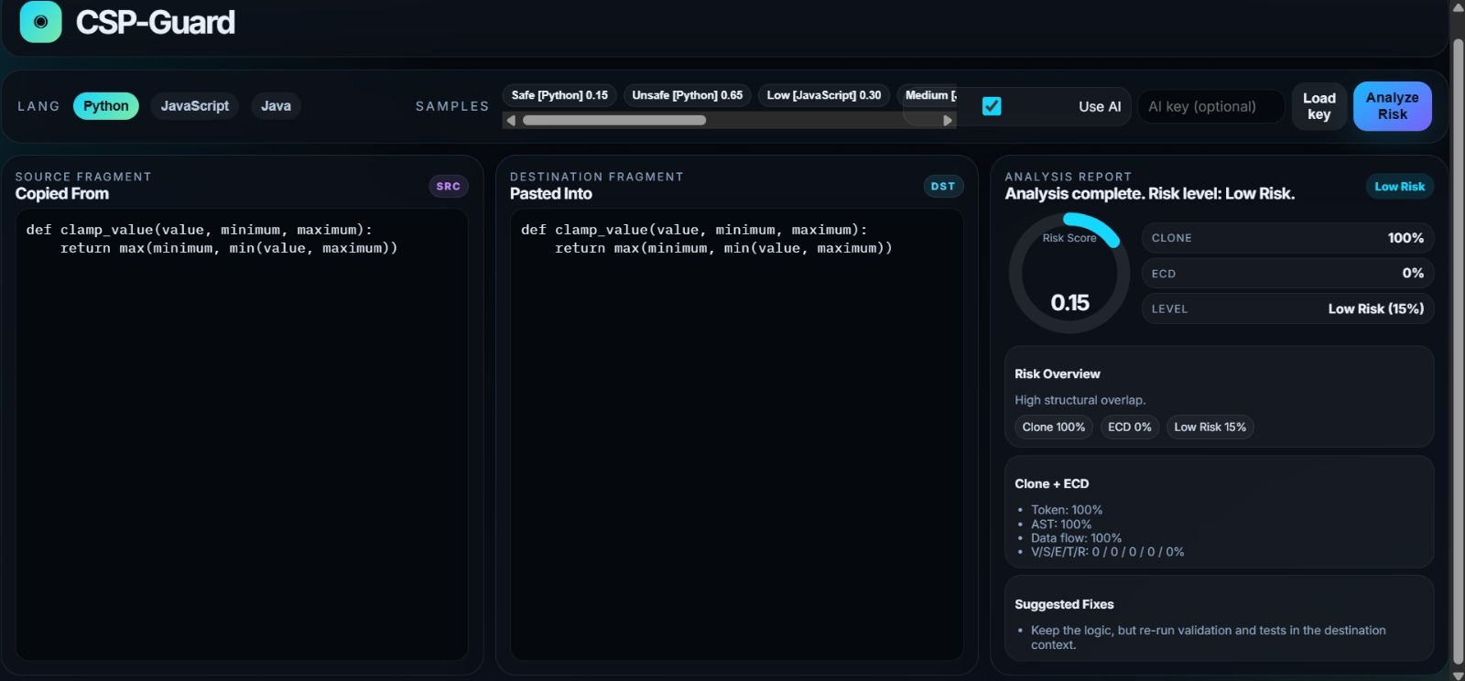
08 Front-End View — CSP-Guard Web Application
medium risk Shows: Taint +
high risk
unsafe
safe
CSP-Guard | SR University, Warangal | 2026

Slide 12
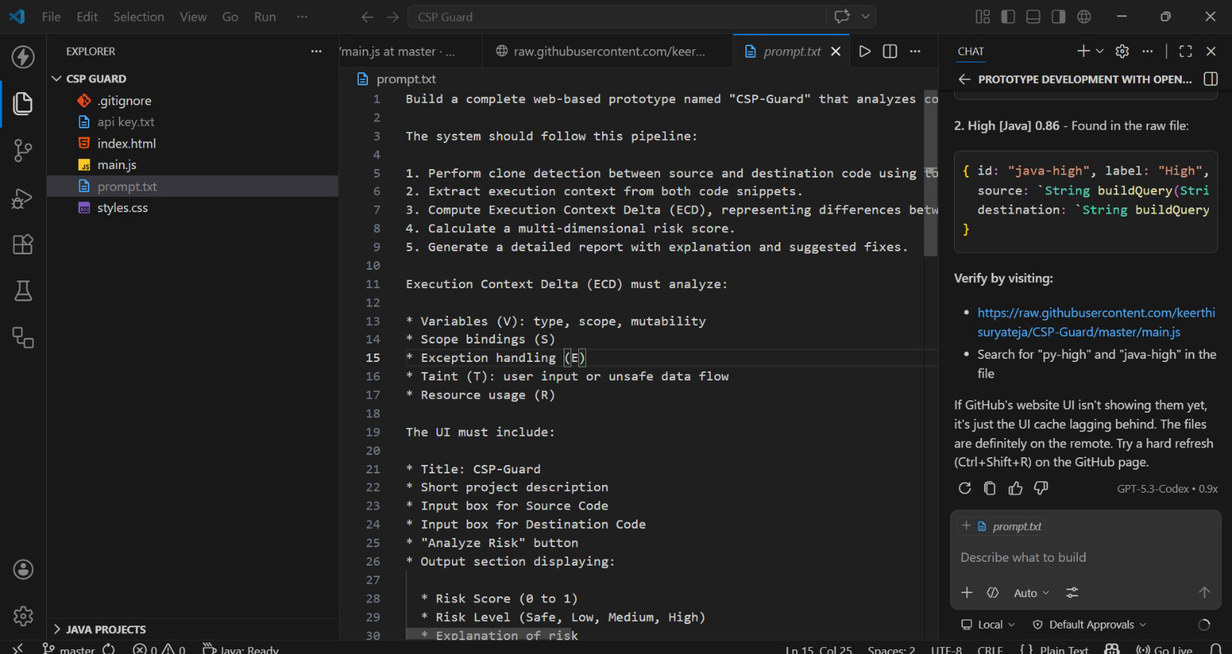
09 Proof of Prompts Generating Code (Screenshots)
P4 → ECD Computation Code
* Actual screenshots from Claude / ChatGPT sessions — placeholder representations shown above.
CSP-Guard | SR University, Warangal | 2026

Slide 13
10 References
[1]
Kamiya, T., Kusumoto, S., & Inoue, K. (2002). CCFinder: A multilinguistic token-based code clone detection system. IEEE Transactions on Software Engineering, 28(7), 654–670.
[2]
Li, Z., et al. (2005). CP-Miner: A tool for finding copy-paste and related bugs in operating system code. OSDI 2004, USENIX.
[3]
Sajnani, H., et al. (2016). SourcererCC: Scaling code clone detection to big code. ICSE 2016, IEEE.
[4]
Clone Detection Using Abstract Syntax Trees, ICSM 1998.
https://doi.org/10.1109/ICSM.1998.738528
[5]
Common Weakness Enumeration (CWE), especially CWE-79, CWE-89, CWE-94.
https://cwe.mitre.org/
[6]
The Program Dependence Graph and Its Use in Optimization, ACM TOPLAS, 1987.
https://doi.org/10.1145/24039.24041
[7]
https://openrouter.ai/docs
[8]
OWASP Top 10 (2023). Open Web Application Security Project — Top 10 Vulnerabilities. https://owasp.org/Top10
[9]
Fetch API and Web Storage API (for frontend-only architecture).
https://developer.mozilla.org/en-US/docs/Web/API/Fetch_API
https://developer.mozilla.org/en-US/docs/Web/API/Web_Storage_API
CSP-Guard

